Slide 1

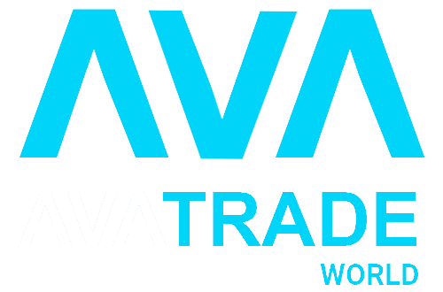
WELCOME TO THE WORLD OF

Slide 2

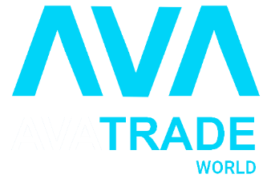

About Us
Since 2006 AvaTrade has expanded enormously; with over 400,000 registered customers globally, executing more than two million trades a month.
The company’s total trading volumes now surpass $70 billion per month. AvaTrade’s user-oriented perspective, combined with solid financial backing, is unique to the field of online trading. From our 24-hour multilingual support desks to our broad range of platforms and services, we have successfully created the optimal trading environment for every level of trader.
www.avatradeworld.com / info@avatradeworld.com / Follow us on

Slide 3


Mission
AvaTrade Pioneering Online Trading Since 2006 We are one of the most secure brokers in the industry, with 9 regulations across 6 continents. We offer a wide choice of assets, leading platforms and generous trading conditions.
Vision
AVA Trade is committed to empowering people to invest and trade, with confidence in an innovative and reliable environment supported by best-in-class personal service and uncompromising integer
www.hammertradex.com / info@hammertradex.com / Follow us on

Slide 4

Our Community
Wherever we go in the globe, we all know that across the globe, one thing is universally true of the people of Accenture.We care deeply about our community and what we do and the impact we have with our clients and communities. It is personal to all of us.
We are committed to give our best service to grow and flourish our community.
www.avatradeworld.com / info@avatradeworld.com / Follow us on

Slide 5



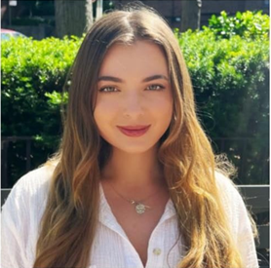
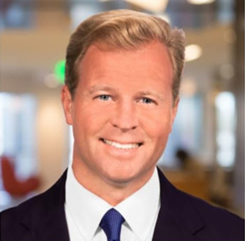
OUR TEAM
DAEJUN PARK CEO
Sagar Dhawan Marketing Head
Anna Seminoma Business Analysis
Brian Quintenz Advisory Partner
www.avatradeworld.com / info@avatradeworld.com / Follow us on

Slide 6

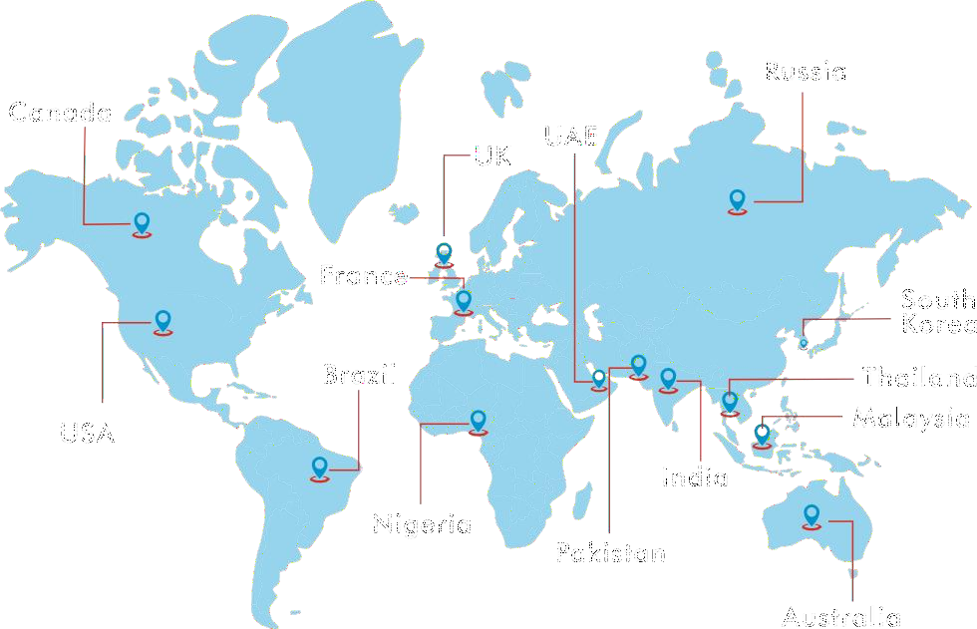

The Increasing significance of Cryptocurrencies across the world ‘AVATRADEWORLD' has decided to launch it's upcoming phase of digital revolutions around the world...
www.avatradeworld.com / info@avatradeworld.com / Follow us on

Slide 7
AVA TRADE WORLD ROADMAP
SEPTEMBER
Own Decentralised Exchange
JANUARY
Global Marketing Company
JUNE
Token Lunch listing on CMC & Major exchange
JANUARY
Crypto gaming launch pad
2023
2024
NOVEMBER
Cross Chain Swap
MARCH
AVA Wallet App
OCTOMBER
Own ATM Chain Worldwide
www.avatradeworld.com / info@avatradeworld.com / Follow us on

Slide 8
EASY TO START
WHY CHOOSE US
NETWORTH POINTS
SAFE & SECURE
DAILY WITHDRAWL
USER FRIENDLY
100%
TRANSPARENCY
www.avatradeworld.com / info@avatradeworld.com / Follow us on

Slide 9
AVA Trade Legal Assest
AVA Trade World EU Ltd is regulated by the Central Bank of Ireland. ( No. C53877 )
AVA Trade World Markets Ltd. is regulated by the B.V.I Financial Services Commission
AVA Trade World Ltd. is regulated in Israel by the Israel Securities Authority ( No. 514666577)
AVA Trade World Markets Australia Pty Ltd is regulated by the ASIC No. 406684.
AVA Trade World Ltd. DT Direct Investment Hub Ltd. is regulated by the Cyprus Securities and Exchange Commission ( No. 347/17 )

Slide 10

What Is Crypto Gaming
While virtual video game money is not a new concept, the advent of blockchain technology has created opportunities for crypto gaming developers to add an element of real-world economics to their games.
Crypto gamers can earn non-fungible tokens (NFTs) or cryptocurrency by playing and winning a game, and those digital assets then become the property of the gamer. In many cases, in-game digital tokens can be exchanged for stable coins on either centralized or decentralized cryptocurrency exchanges.

Slide 11

What Is Cryptocurrency Wallet
A cryptocurrency wallet is an application that functions as a wallet for your cryptocurrency. It is called a wallet because it is used similarly to a wallet you put cash and cards in. Instead of holding these physical items, it stores the passkeys you use to sign for your cryptocurrency transactions and provides the interface that lets you access your crypto.
Modern cryptocurrency wallets make the blockchain accessible to everyone. When cryptocurrency was first introduced, sending cryptocurrency was a manual task that required entering long keys. Today, the software does most of it for you.

Slide 12
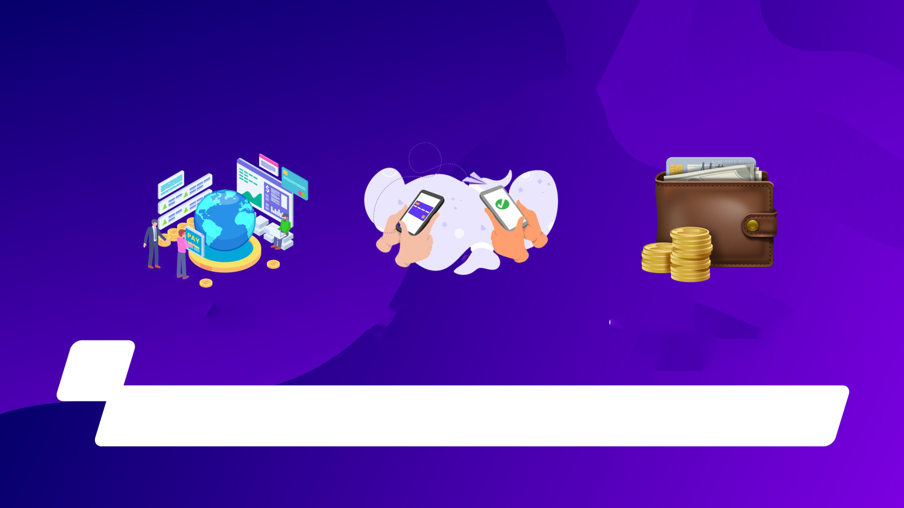
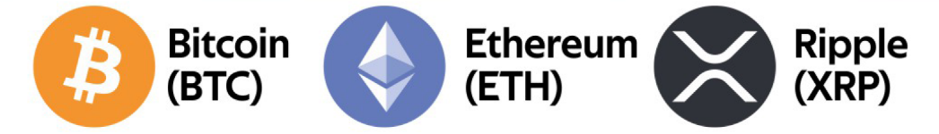
What is Crypto Currency?
How Blockchain Works ?
This handy tool helps you create dummy text fo
How Blockchain Works ?
This handy tool helps you create dummy text fo
How Blockchain Works ?
This handy tool helps you create dummy text fo
Examples of cryptocurrencey
www.avatradeworld.com / info@avatradeworld.com / Follow us on

Slide 13
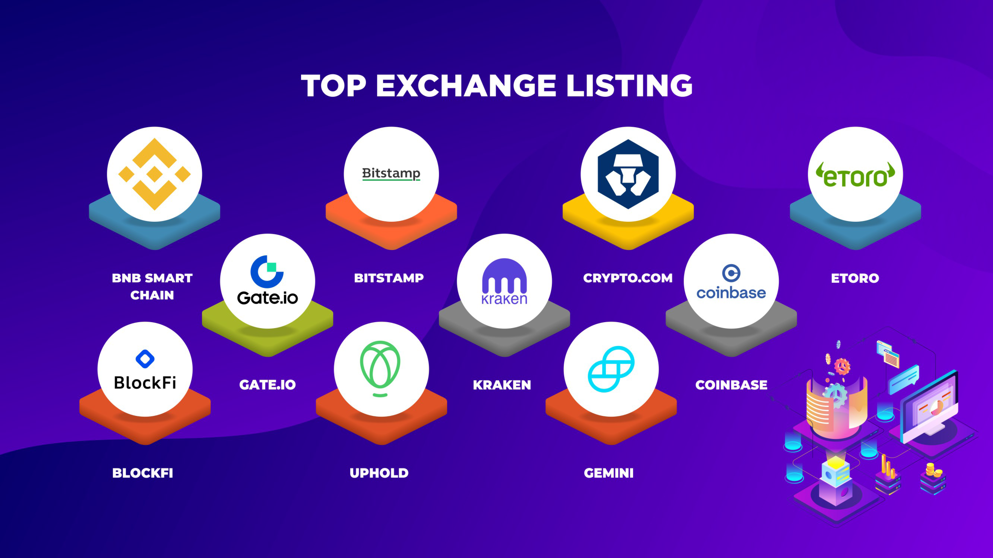
www.avatradeworld.com / info@avatradeworld.com / Follow us on

Slide 14

BUSINESS
OPPORTUNITY
www.avatradeworld.com / info@avatradeworld.com / Follow us on

Slide 15

JOINING PACKAGE
MIN
$20
MAX
$15000
JOINING PACKAGE
www.avatradeworld.com / info@avatradeworld.com / Follow us on

Slide 16
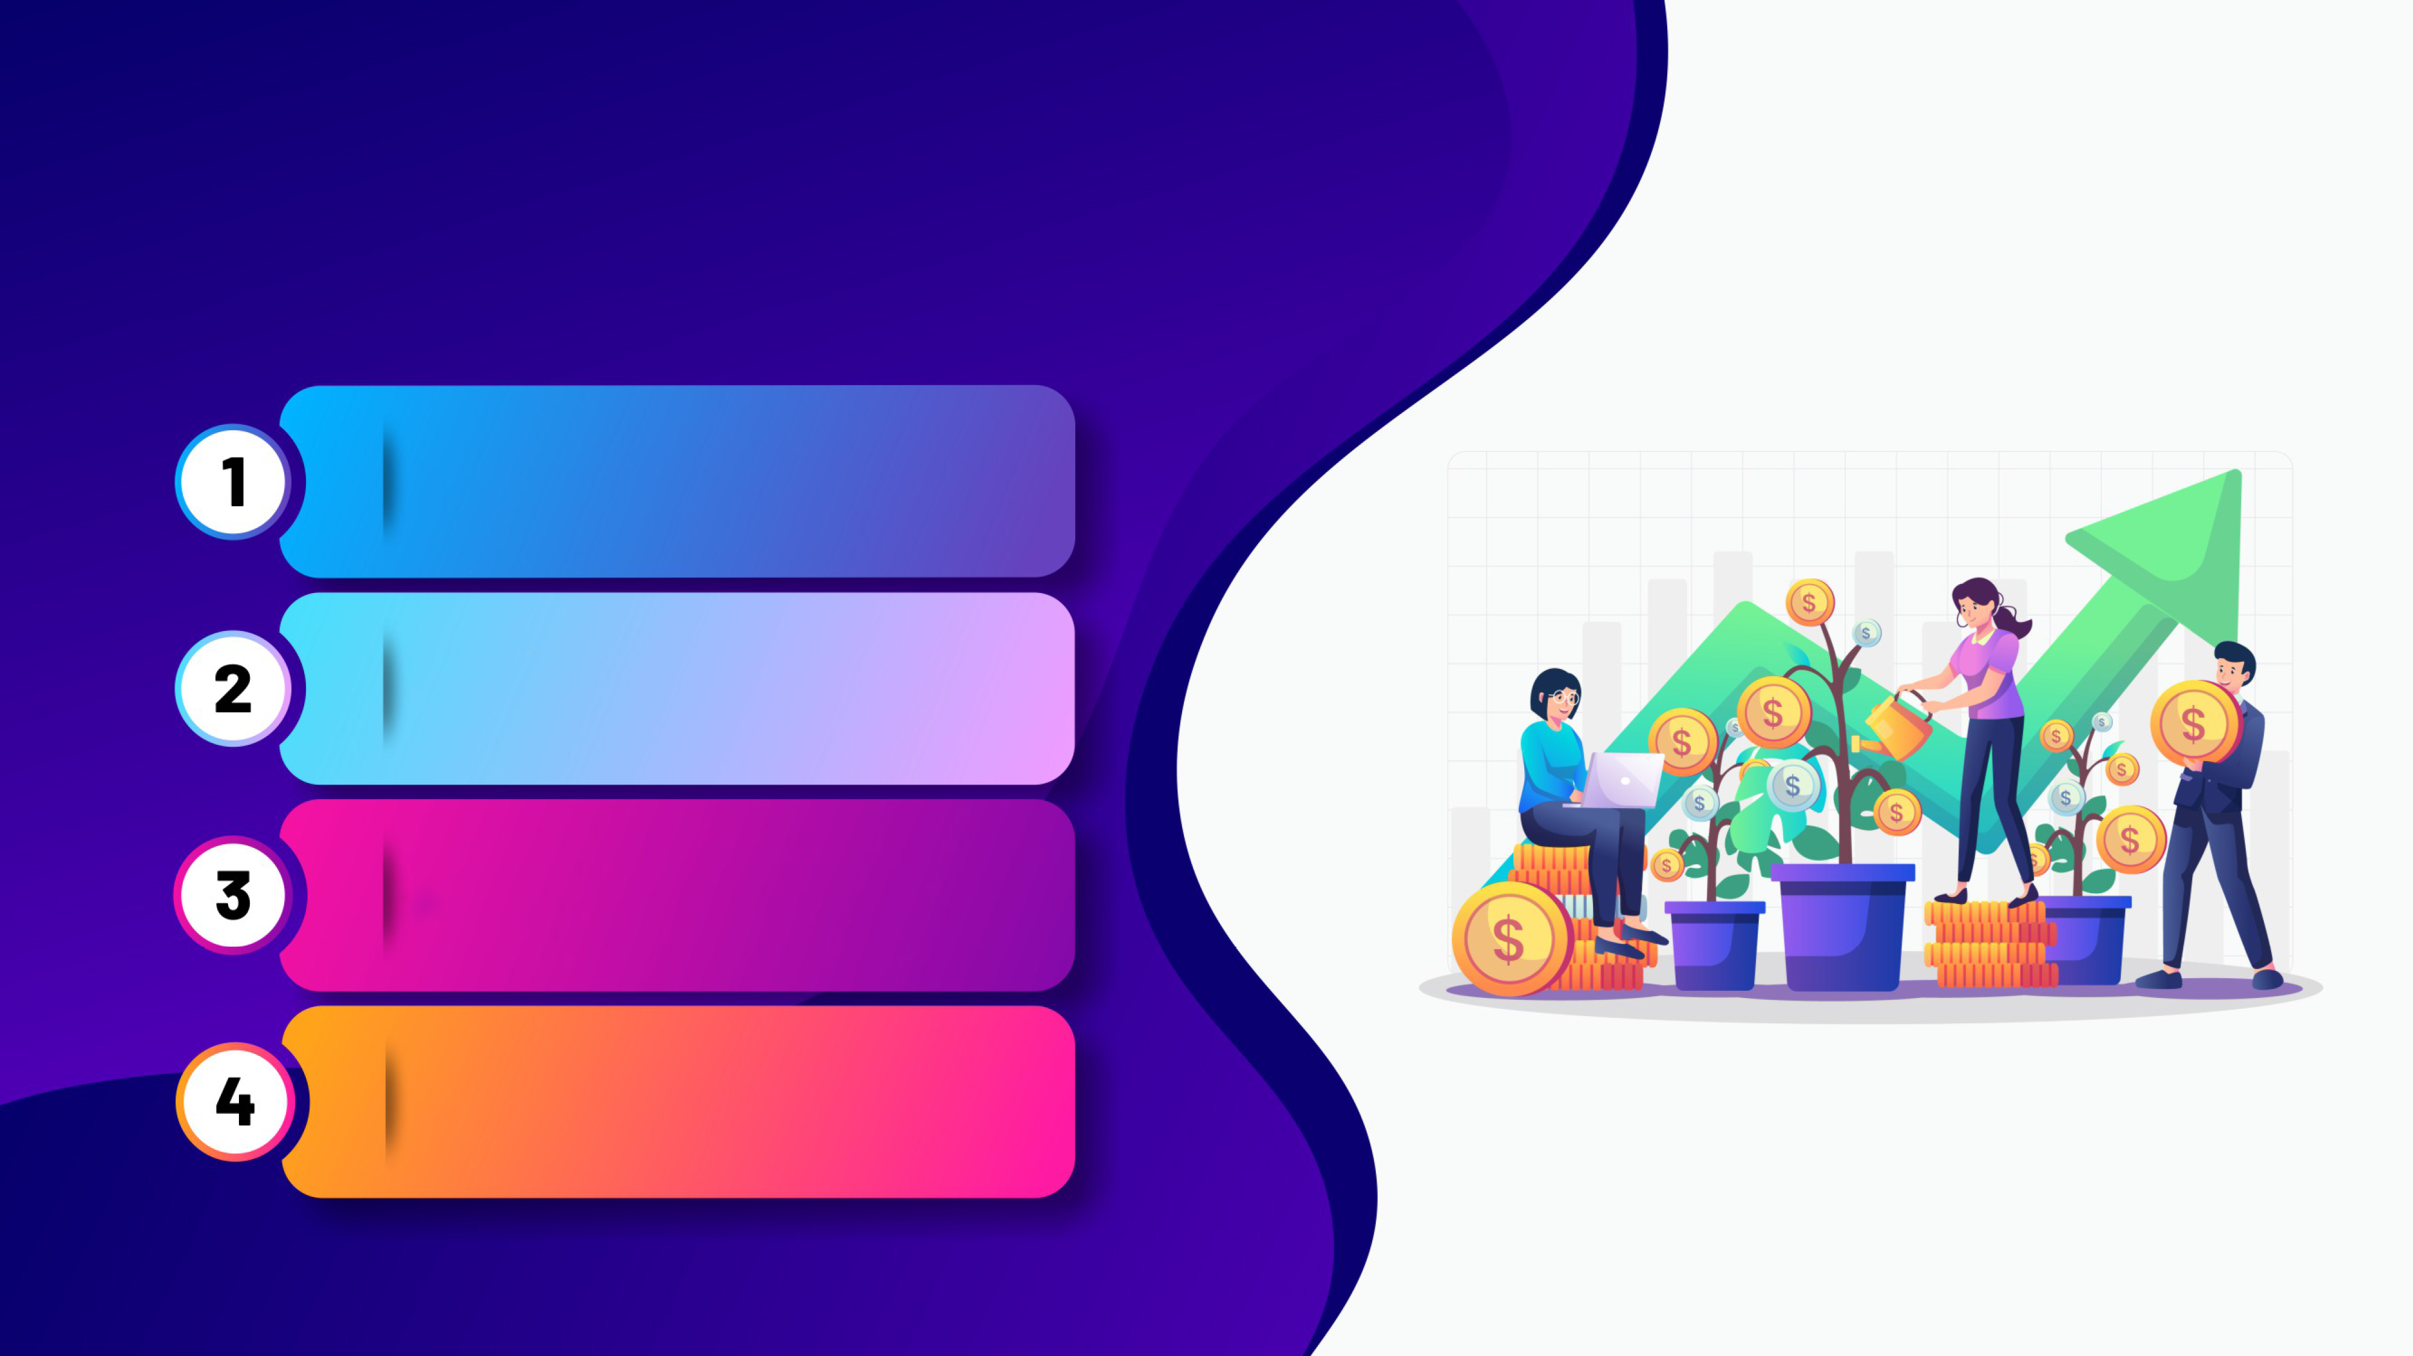
TYPES OF INCOME
AVA DIRECT
SPONSOR INCOME
AVA DAILY TRADE PROFIT
AVA LEVEL INCOME
AVA PERFORMANCE BONUS
www.avatradeworld.com / info@avatradeworld.com / Follow us on

Slide 17


1• AVA DIRECT SPONSOR INCOME
5%
Unlimited
If You Refers Anyone You will Gets 5%
As A Referral
Dividend Bonus.
www.avatradeworld.com / info@avatradeworld.com / Follow us on

Slide 18

2• AVA DAILY TRADE PROFIT
Days | Income
21 | 0.5%
45 | 0.75%
60 | 1%
90 | 1.25%
120 | 1.5%
www.avatradeworld.com / info@avatradeworld.com / Follow us on

Slide 19


3. AVA LEVEL INCOME
1st Level - 10%
4
4th - 5th Level - 7%
2nd Level - 10%
5
6th - 10th Level - 5%
3rd Level - 7%
6
11th - 15th Level - 3%
www.avatradeworld.com / info@avatradeworld.com / Follow us on

Slide 20
4• AVA PERFORMANCE BONUS
SR.NO | DIRECT BUSINESS | Team Business | INCOME | RANK | DAYS
1 | $ 100 | $ 3000 | $10 | AVA Trader | 30
2 | $ 200 | $ 7000 | $20 | AVA Smart Trader | 45
3 | $ 500 | $ 14000 | $50 | AVA Pro Trader | 45
4 | $ 1000 | $ 30000 | $100 | AVA Bronze Trader | 45
5 | $ 1500 | $ 60000 | $200 | AVA Silver Trader | 45
6 | $ 2000 | $ 120000 | $400 | AVA Gold Trader | Lifetime
7 | $ 3000 | $ 200000 | $800 | AVA Platinum Trader | Lifetime
8 | $ 5000 | $ 500000 | $1500 | AVA Dimond Trader | Lifetime
9 | $ 10000 | $ 1000000 | $3000 | AVA Pearl Trader | Lifetime
10 | $ 20000 | $ 2000000 | $5000 | AVA Emerald | Lifetime

Slide 21
Terms & Conditions
Registration Free.
Activation Only Minimum $ 20.
Minimum Withdrawal $20.
Minimum Investment $100 for level income.
Earning Potential Is 3 X ( 3 Times )
For Example:- If You Invest $100, You May Earn 3 Times I.E. $300.
You Have To Reinvest Your Account After Getting 3X ( 3 Times of Your Investment ) to Continue Getting Smooth Earnings.
The Deduction Will Be 10% and Will Apply To Every Withdrawal.
Principal Amount Withdraw anytime.
Matching will be calculated on 40:40:20 ratio

Slide 22

3• AVA DAILY TRADE PROFIT
THANK YOU
www.avatradeworld.com / info@avatradeworld.com

